Slide 1
Linear Spaces
● Definitions
● Subspaces
● Linear Combinations
● Linear Independence
● Basis and Dimension
● Rank and Nullity

Slide 2
A point in n-dimensional space, denoted R^{n}, has coordinates (x₁, x₂, …, x_{n}) and vectors
have the form

Slide 3
Linear Spaces
A set of objects V is called a linear space or vector space under the operations of addition and scalar multiplication if it satisfies the following conditions.
1. If a and b are objects in V then a + b is an
object in V.
2. a + b = b + a.
3. If a, b and c are objects in V then
a + (b + c) = (a + b) + c
4. There exists an object 0 in V such that
a + 0 = 0 + a = a for all a in V.
0 is called the zero vector.

Slide 4
5. For each object a in V there is an object –a
in V called the negative of a such that
a + (-a) = (-a) + a = 0.
6. If a is any object in V and k is any scalar
then ka is an object in V.
7. k(a + b) = ka + kb.
8. (k + l) a = ka + la for any scalars k and l.
9. k(la) = (kl)a.
10. 1u = u.

Slide 5

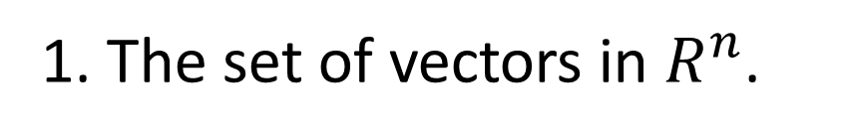
Examples:
1. The set of vectors in $R^{n}$.
2. The set of all matrices $\left\{{\left[a_{ij}\right]}_{m×n}\right\}$.
3. The set of all functions.
4. The solutions of Ax = 0.

Slide 6
Subspaces
If V is a linear space and W is a subset of V then W is a subspace of V if W itself is a linear space. The set W is a subspace of the linear space V if and only if
1. If a and b are in W, a + b is in W.
2. If k is any scalar and a is a vector in W, ka is in W.

Slide 7
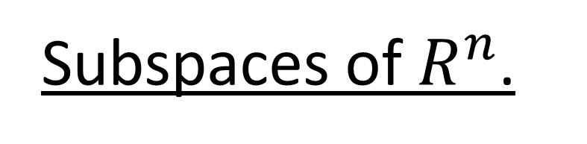
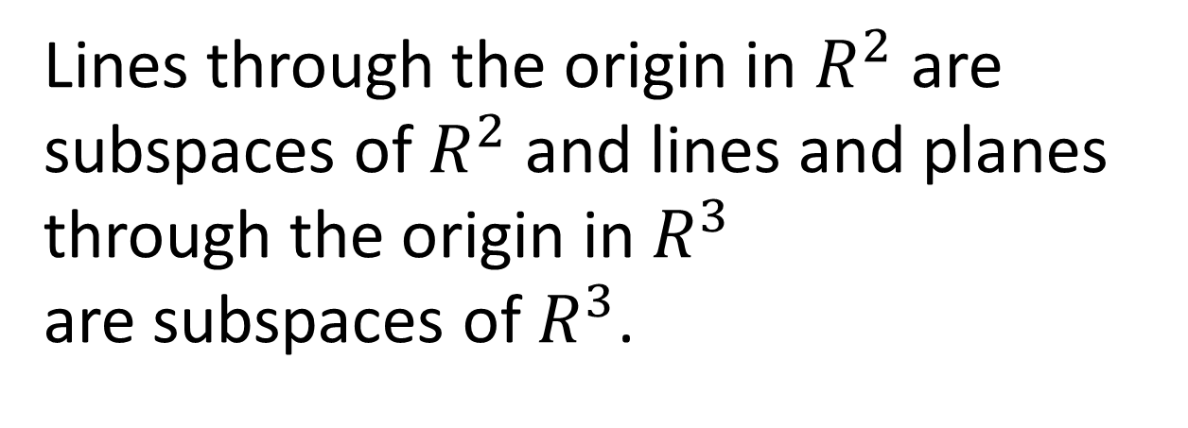
Subspaces of $R^{n}$.
Theorem:
Lines through the origin in $R^{2}$ are subspaces of $R^{2}$ and lines and planes through the origin in $R^{3}$
are subspaces of $R^{3}$.

Slide 8
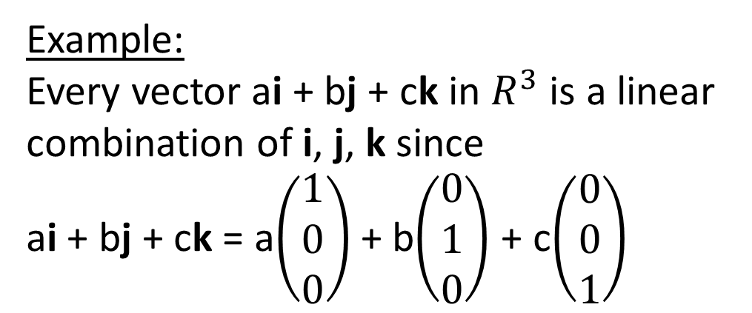
Linear Combinations
The vector w is called a linear combination of the vectors v₁, v₂, …, v_{r} if it can be expressed in the form
w = k₁v₁ + k₂v₂ + … + k_{r}v_{r} where k₁, k₂, …, k_{r} are scalars.
Example:
Every vector ai + bj + ck in $R^{3}$ is a linear
combination of i, j, k since
ai + bj + ck = a$\left(\begin{matrix}1 \\ 0 \\ 0\end{matrix}\right)$ + b$\left(\begin{matrix}0 \\ 1 \\ 0\end{matrix}\right)$ + c$\left(\begin{matrix}0 \\ 0 \\ 1\end{matrix}\right)$

Slide 9
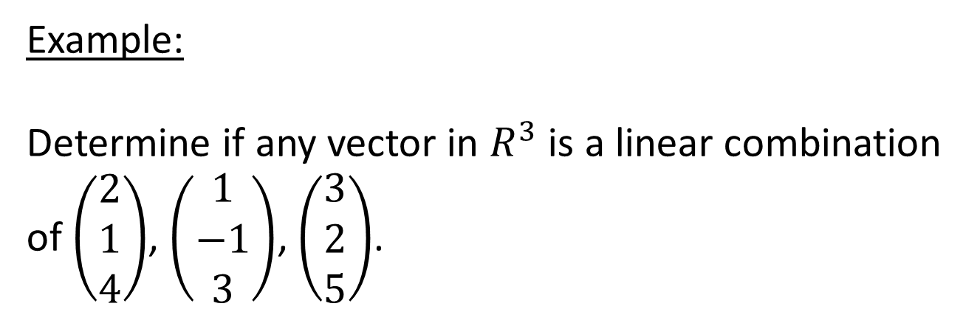
Example:
Determine if any vector in $R^{3}$ is a linear combination
of $\left(\begin{matrix}2 \\ 1 \\ 4\end{matrix}\right)$, $\left(\begin{matrix}1 \\ −1 \\ 3\end{matrix}\right)$, $\left(\begin{matrix}3 \\ 2 \\ 5\end{matrix}\right)$.

Slide 10
If
and

Slide 11
|A| = -22+3+21 = 2
adj A
A⁻¹

Slide 12
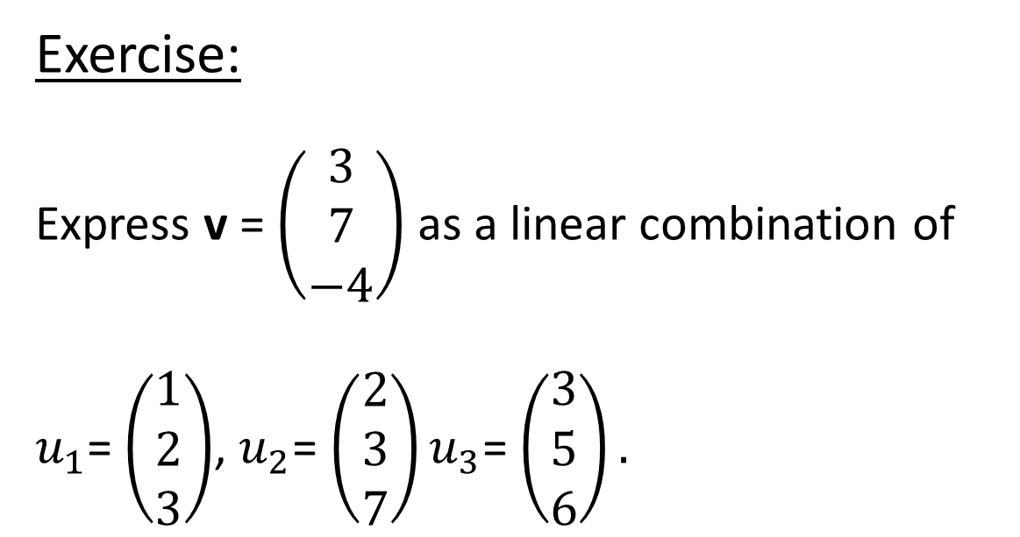
Exercise:
Express v = $\left(\begin{matrix}3 \\ 7 \\ −4\end{matrix}\right)$ as a linear combination of
$u_{1}$= $\left(\begin{matrix}1 \\ 2 \\ 3\end{matrix}\right)$, $u_{2}$= $\left(\begin{matrix}2 \\ 3 \\ 7\end{matrix}\right)u_{3}$= $\left(\begin{matrix}3 \\ 5 \\ 6\end{matrix}\right).$

Slide 13
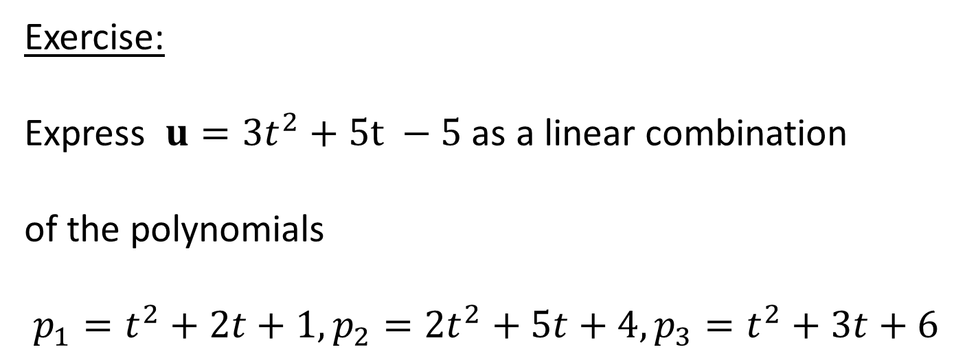
Exercise:
Express $u=3t^{2}+5t −5$ as a linear combination
of the polynomials
$${p_{1}=t}^{2}+2t+1,{p_{2}=2t}^{2}+5t+4,p_{3}=t^{2}+3t+6$$

Slide 14
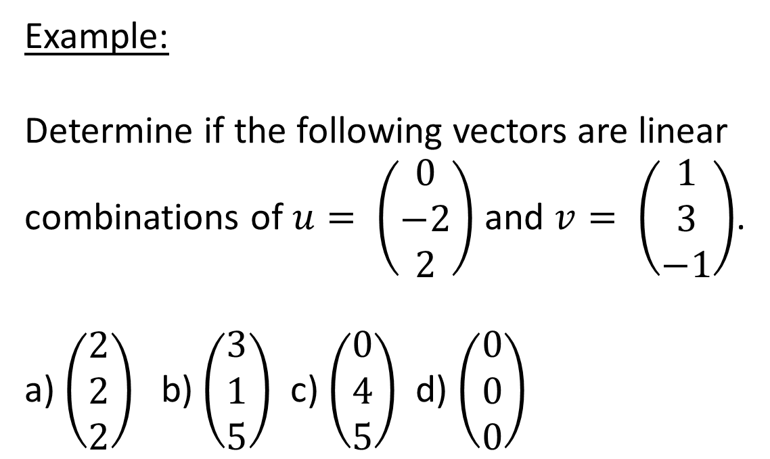
Example:
Determine if the following vectors are linear
combinations of $u= \left(\begin{matrix}0 \\ −2 \\ 2\end{matrix}\right)$ and $v= \left(\begin{matrix}1 \\ 3 \\ −1\end{matrix}\right)$.
a) $\left(\begin{matrix}2 \\ 2 \\ 2\end{matrix}\right)$ b) $\left(\begin{matrix}3 \\ 1 \\ 5\end{matrix}\right)$ c) $\left(\begin{matrix}0 \\ 4 \\ 5\end{matrix}\right)$ d) $\left(\begin{matrix}0 \\ 0 \\ 0\end{matrix}\right)$

Slide 15
a)

Slide 16
b)

Slide 17
c)
no solution.

Slide 18
d)

Slide 19
Spanning
If v₁, v₂, …, v_{r} are vectors in a linear space V the subspace W of V consisting of all linear combinations of v₁, v₂, …, v_{r},
W = {k₁v₁ + k₂v₂ + … + k_{r}v_{r}} is called the space spanned by v₁, v₂, …, v_{r} and we say that the vectors v₁, v₂, …, v_{r} span W.

Slide 20
Example:
For a vector v, span{v} is the line through the origin determined by v since the line is the set of all multiples of the vector v.

Slide 21
Example:
For two nonparallel vectors v₁, v₂,
span{v₁, v₂} is the plane through the origin determined by v₁ and v₂ since the plane is the set of all linear combinations of v₁ and v₂.

Slide 22
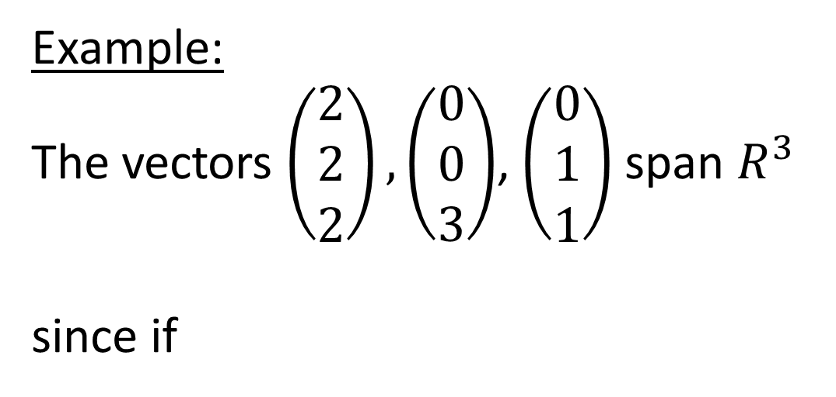
Example:
The vectors $\left(\begin{matrix}2 \\ 2 \\ 2\end{matrix}\right), \left(\begin{matrix}0 \\ 0 \\ 3\end{matrix}\right)$, $\left(\begin{matrix}0 \\ 1 \\ 1\end{matrix}\right)$span $R^{3}$
since if

Slide 23
since

Slide 24
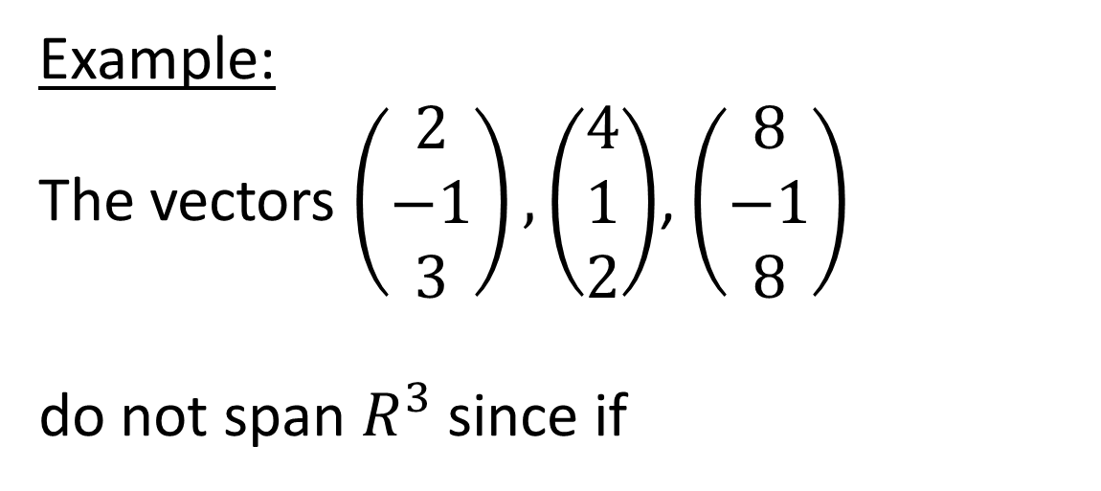
Example:
The vectors $\left(\begin{matrix}2 \\ −1 \\ 3\end{matrix}\right), \left(\begin{matrix}4 \\ 1 \\ 2\end{matrix}\right)$, $\left(\begin{matrix}8 \\ −1 \\ 8\end{matrix}\right)$
do not span $R^{3}$ since if

Slide 26
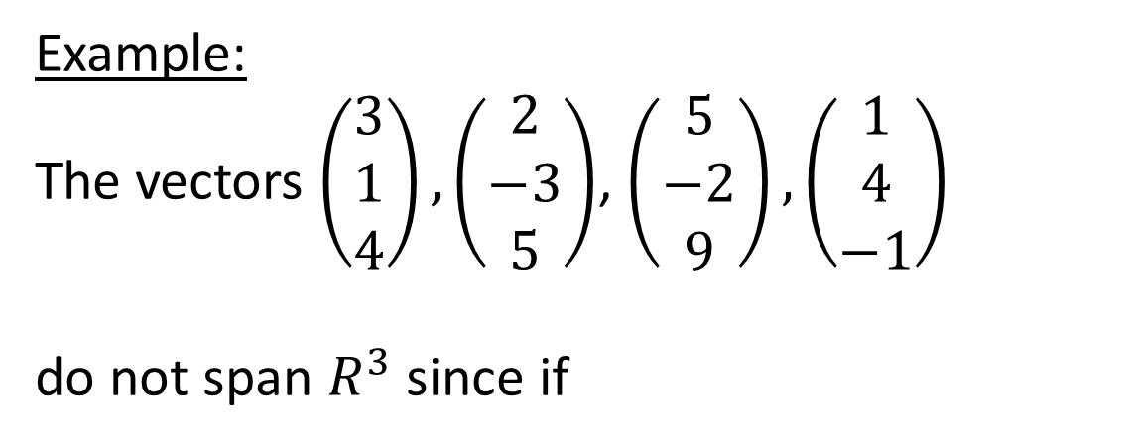
Example:
The vectors $\left(\begin{matrix}3 \\ 1 \\ 4\end{matrix}\right), \left(\begin{matrix}2 \\ −3 \\ 5\end{matrix}\right)$, $\left(\begin{matrix}5 \\ −2 \\ 9\end{matrix}\right),\left(\begin{matrix}1 \\ 4 \\ −1\end{matrix}\right)$
do not span $R^{3}$ since if
= k₁v₁ + k₂v₂ + k₃v₃ + k₄v₄
= k₁v₁ + k₂v₂ + k₃v₃ + k₄(v₁ – v₂)
= (k₁ + k₄)v₁ + (k₂ – k₄)v₂ + k₃v₃
= c₁v₁ + c₂v₂ + c₃v₃

Slide 28
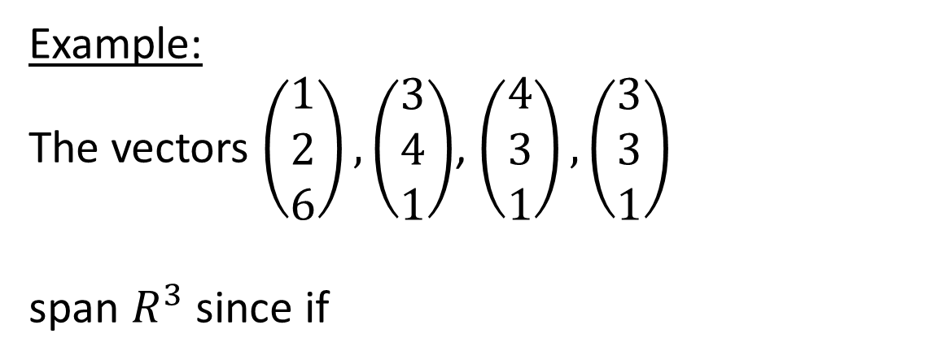
Example:
The vectors $\left(\begin{matrix}1 \\ 2 \\ 6\end{matrix}\right), \left(\begin{matrix}3 \\ 4 \\ 1\end{matrix}\right)$, $\left(\begin{matrix}4 \\ 3 \\ 1\end{matrix}\right),\left(\begin{matrix}3 \\ 3 \\ 1\end{matrix}\right)$
span $R^{3}$ since if
= k₁v₁ + k₂v₂ + k₃v₃ + k₄v₄
= k₁v₁ + k₂v₂ + k₃v₃ + k₄(v₁ – v₂)
= (k₁ + k₄)v₁ + (k₂ – k₄)v₂ + k₃v₃
= c₁v₁ + c₂v₂ + c₃v₃

Slide 29
Let

Slide 31
= k₁v₁ + k₂v₂ + k₃v₃ + k₄v₄
= k₁(-16v₂ - 17v₃ + 39v₄) + k₂v₂ + k₃v₃ + k₄v₄
= (k₂ -16k₁)v₂ + (k₃ – 17k₁)v₃+ (39k₁ + k₄)v₄
= c₂v₂ + c₃v₃ + c₄v₄

Slide 33
Since
v₁, v₂, v₃, v₄ span R³.

Slide 34
Linear Independence
If v₁, v₂, …, v_{r} are vectors then the vector equation k₁v₁ + k₂v₂ + … + k_{r}v_{r} = 0 has the solution
k₁ = k₂ = … = k_{r} = 0. If this is the only solution, then the vectors v₁, v₂, …, v_{r} are linearly independent. If there are other solutions,
then v₁, v₂, …, v_{r} are linearly dependent.

Slide 35
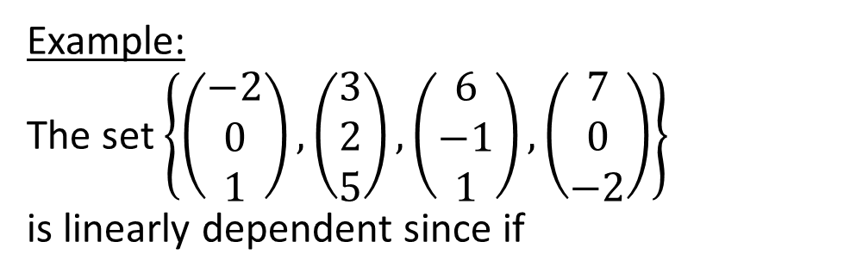
Example:
The set $\left\{\left(\begin{matrix}−2 \\ 0 \\ 1\end{matrix}\right),\left(\begin{matrix}3 \\ 2 \\ 5\end{matrix}\right),\left(\begin{matrix}6 \\ −1 \\ 1\end{matrix}\right),\left(\begin{matrix}7 \\ 0 \\ −2\end{matrix}\right)\right\}$
is linearly dependent since if

Slide 38
Linearly dependent.

Slide 39
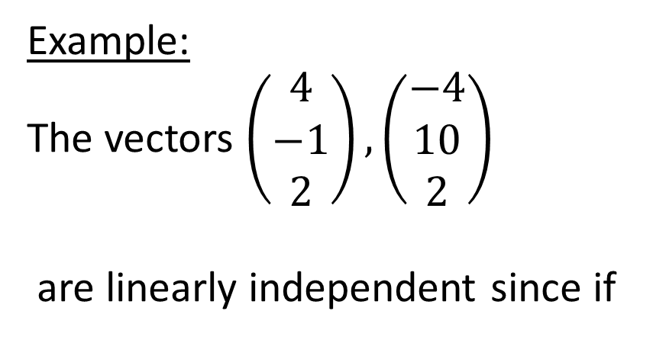
Example:
The vectors $\left(\begin{matrix}4 \\ −1 \\ 2\end{matrix}\right), \left(\begin{matrix}−4 \\ 10 \\ 2\end{matrix}\right)$
are linearly independent since if

Slide 41
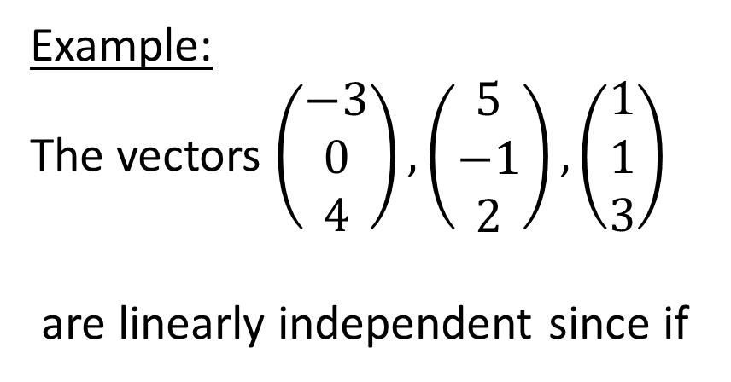
Example:
The vectors $\left(\begin{matrix}−3 \\ 0 \\ 4\end{matrix}\right), \left(\begin{matrix}5 \\ −1 \\ 2\end{matrix}\right), \left(\begin{matrix}1 \\ 1 \\ 3\end{matrix}\right)$
are linearly independent since if

Slide 43
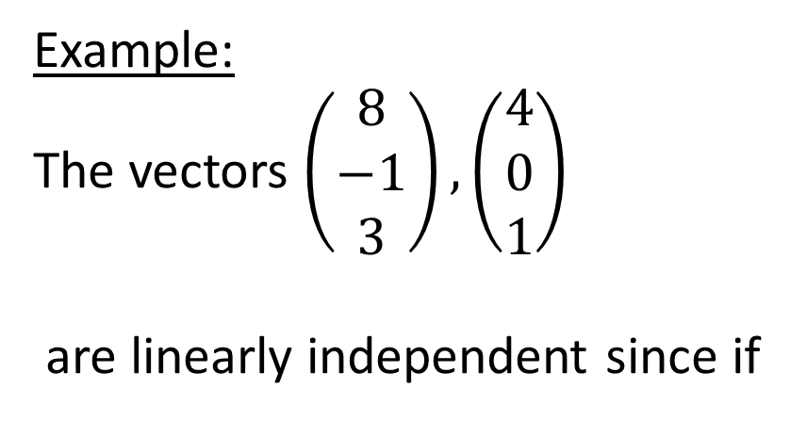
Example:
The vectors $\left(\begin{matrix}8 \\ −1 \\ 3\end{matrix}\right), \left(\begin{matrix}4 \\ 0 \\ 1\end{matrix}\right)$
are linearly independent since if

Slide 45
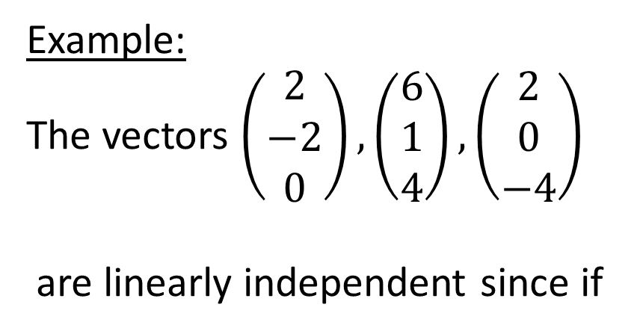
Example:
The vectors $\left(\begin{matrix}2 \\ −2 \\ 0\end{matrix}\right), \left(\begin{matrix}6 \\ 1 \\ 4\end{matrix}\right), \left(\begin{matrix}2 \\ 0 \\ −4\end{matrix}\right)$
are linearly independent since if

Slide 47
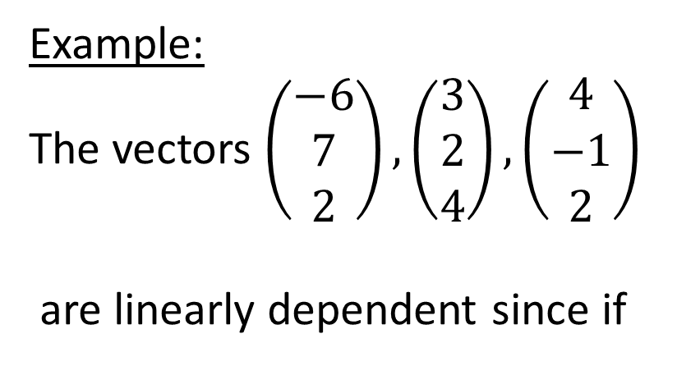
Example:
The vectors $\left(\begin{matrix}−6 \\ 7 \\ 2\end{matrix}\right), \left(\begin{matrix}3 \\ 2 \\ 4\end{matrix}\right), \left(\begin{matrix}4 \\ −1 \\ 2\end{matrix}\right)$
are linearly dependent since if

Slide 49
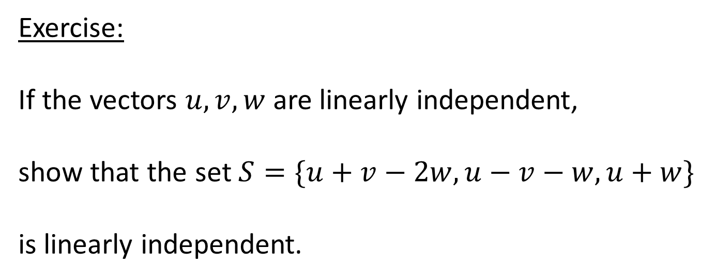
Exercise:
If the vectors $u,v,w$ are linearly independent,
show that the set $S=\{u+v−2w, u−v−w, u+w\}$
is linearly independent.

Slide 50
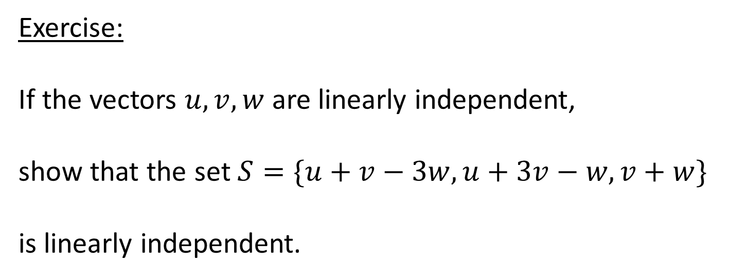
Exercise:
If the vectors $u,v,w$ are linearly independent,
show that the set $S=\{u+v−3w, u+3v−w, v+w\}$
is linearly independent.

Slide 51
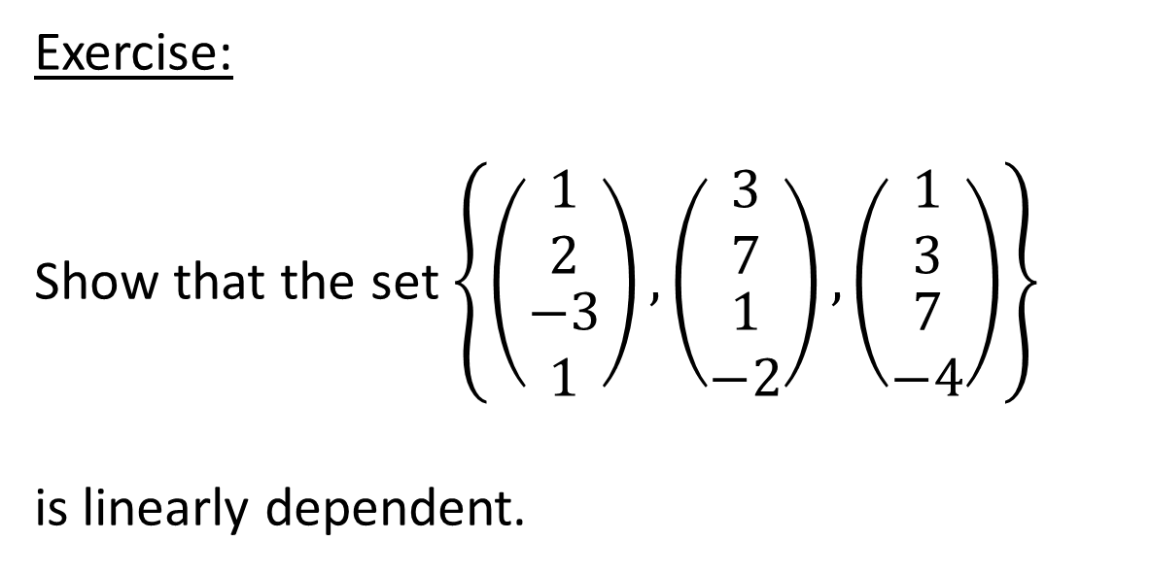
Exercise:
Show that the set $\left\{\left(\begin{matrix}\begin{matrix}1 \\ 2\end{matrix} \\ \begin{matrix}−3 \\ 1\end{matrix}\end{matrix}\right),\left(\begin{matrix}\begin{matrix}3 \\ 7\end{matrix} \\ \begin{matrix}1 \\ −2\end{matrix}\end{matrix}\right),\left(\begin{matrix}\begin{matrix}1 \\ 3\end{matrix} \\ \begin{matrix}7 \\ −4\end{matrix}\end{matrix}\right)\right\}$
is linearly dependent.

Slide 52
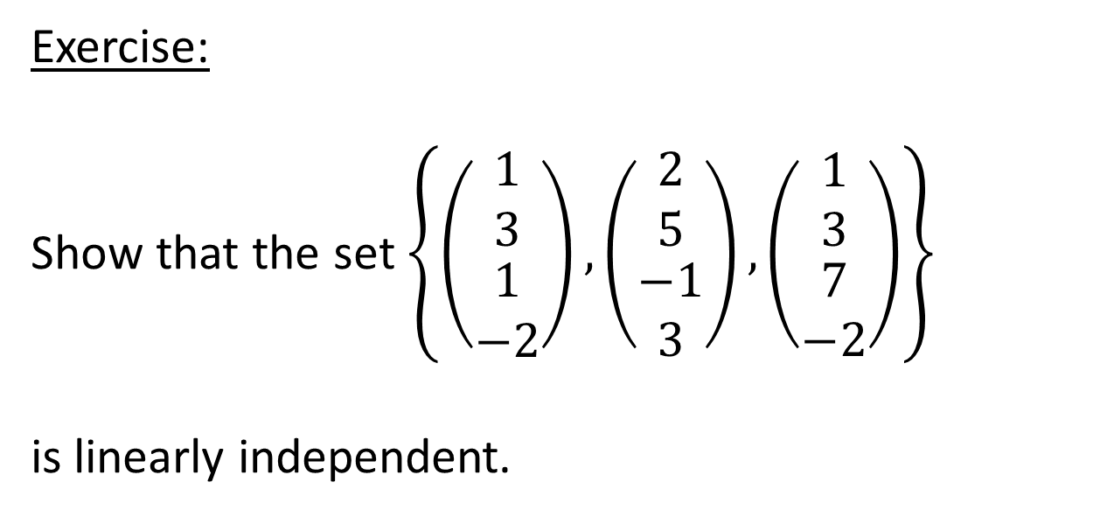
Exercise:
Show that the set $\left\{\left(\begin{matrix}\begin{matrix}1 \\ 3\end{matrix} \\ \begin{matrix}1 \\ −2\end{matrix}\end{matrix}\right),\left(\begin{matrix}\begin{matrix}2 \\ 5\end{matrix} \\ \begin{matrix}−1 \\ 3\end{matrix}\end{matrix}\right),\left(\begin{matrix}\begin{matrix}1 \\ 3\end{matrix} \\ \begin{matrix}7 \\ −2\end{matrix}\end{matrix}\right)\right\}$
is linearly independent.

Slide 53
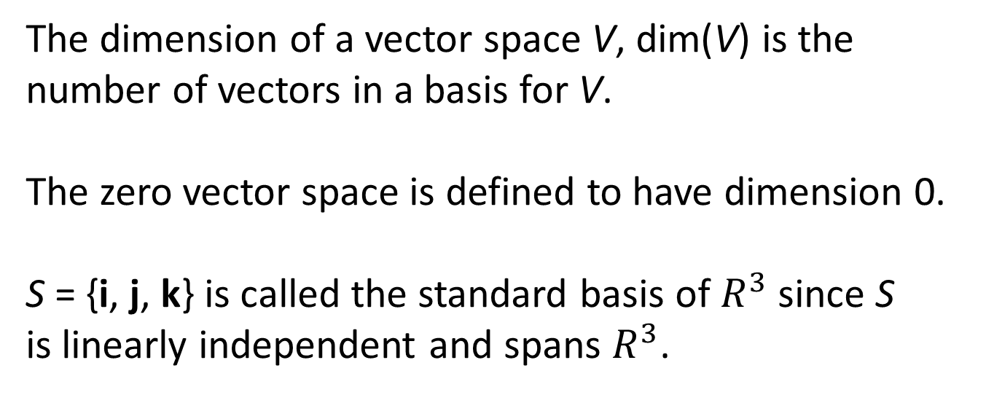
Basis and Dimension
If V is a vector space and S is a set of vectors in V,
S = {v₁, v₂, …, v_{n}}, S is called a basis of V if the vectors in S are linearly independent and S spans V.
The dimension of a vector space V, dim(V) is the number of vectors in a basis for V.
The zero vector space is defined to have dimension 0.
S = {i, j, k} is called the standard basis of $R^{3}$ since S
is linearly independent and spans $R^{3}$.

Slide 54
Theorem:
If v₁, v₂, …, v_{r} form the basis of the nullspace of A, that is form the solution space of the system Ax = 0 and x₀ is a solution of the inhomogeneous system
Ax = b, that is Ax₀ = b then every solution x of Ax = b has the form x = x₀ + c₁v₁ + c₂v₂ + … + c_{r}v_{r}.

Slide 55
Example:
Solve the system

Slide 57
The solution of the
system Ax = 0 is

Slide 58
Example:
Solve the system

Slide 60
The solution of the
system Ax = 0 is

Slide 61
Example:
Solve the system

Slide 64
The solution of the
system Ax = 0 is

Slide 65
If A =
the vectors r₁ = [a₁₁ a₁₂ … a_{1n}],
r₂ = [a₂₁ a₂₂ … a_{2n}], …, r_{m} = [a_{m1} a_{m2} … a_{mn}]
are called the row vectors of A and the vectors
c₁ =
, c₂ =
, …, c_{n} =
are called the column vectors of A.

Slide 66
Row Space, Column Space and Nullspace
The subspace spanned by the row vectors of A is called the row space of A and the subspace spanned by the column vectors is called the column space of A.
The solution space of the system Ax = 0 is called the nullspace of A.

Slide 67
Rank and Nullity
The rank of A, denoted rank A, is the dimension of the row and column space of A.
The nullity of A, denoted nullity A, is the dimension of the nullspace of A.

Slide 68
Dimension Theorem for matrices.
If A is a matrix of size m × n, A =
rank A + nullity A = n.

Slide 69
Example:
Find rank A, nullity A, the null space of A
and a basis for the row and column space of A if
A =

Slide 72
r₁ = (1, -1, 3)
r₂ = (0, 1, -19)
c₁
c₂
rank A = 2
nullity A = 1

Slide 73
Example:
Find rank A, nullity A, the null space of A
and a basis for the row and column space of A if
A =

Slide 76
r₁
c₁
rank A = 1
nullity A = 2

Slide 77
Example:
Find rank A, nullity A, the null space of A
and a basis for the row and column space of A if
A =

Slide 81
r₁
r₂
c₁
c₂
rank A = 2
nullity A = 2

Slide 82
Example:
Find rank A, nullity A, the null space of A
and a basis for the row and column space of A if
A =

Slide 85
Let

Slide 87
r₁ = (1, 4, 5, 6, 9)
r₂ = (0, 1, 1, 1, 2)
c₁
c₂
rank A = 2
nullity A = 3

Slide 88
Example:
Find rank A, nullity A, the null space of A
and a basis for the row and column space of A if
A =

Slide 96
r₁ =
r₂ =
r₃ =
c₁ =
c₂ =
c₃ =
rank (A) = 3
nullity (A) = 2

Slide 97
Example:
If A =
find the rank of A.

Slide 102
Example:
If A =
find the rank of A.

Slide 105
rank A = 2

Slide 106
rank A = 2

Slide 107
rank A = 3

Slide 108
The linear transformation T: R⁴ → R⁴ is represented by the matrix
M =
Example:
i) Find the rank of M.
ii) Obtain a basis for the null space, K, of T.

Slide 109
iii) Evaluate M
and hence show that any solution of
Mx =
(*)
has the form
+λe₁ + μe₂,
where λ and μ are constants and {e₁, e₂} is a basis for K.

Slide 110
iv) Find the solution x₁ of (*) such that the first
component of x₁ is A, and the sum of all the
components of x₁ is B.

Slide 111
i)
rank M = 2

Slide 112
ii)

Slide 113
Let
and
A basis for the null space, K, of T is

Slide 114
iii) M
Since
is a solution of the equation

Slide 115
Mx
and
forms a basis for K,
any solution of (*) has the form
where λ and μ are constants.

Slide 116
iv) If x₁ =
and

Slide 117
X₁

Slide 118
Example:
The linear transformation T: R⁴ → R⁴ is represented
by the matrix
M =
, e is a constant.
The null space of T is denoted by K₁ when e ≠ 0 and by K₂ when e = 0.

Slide 119
i) Find a basis for K₁ and a basis for K₂.
ii) Verify that K₁ is a subspace of K₂.
iii) If the set V consists of the zero vector
together with the vectors in K₂ which are
not in K₁, determine whether V is a
vector space.

Slide 120
i)

Slide 121
If e ≠ 0 let
A basis for the null space, K₁, of T is

Slide 122
If e = 0 Let
A basis for the null space, K₂, of T is

Slide 123
ii) If K₁ is a subspace of K₂ then
Since
K₁ is a subspace of K₂.

Slide 124
iii) If x, y
V = K₂ \ K₁, let
x =
y =
since x, y
x + y =

Slide 125
If x + y =
that is x + y
then
If
that is
x + y
x + y
V is not a vector space.

Slide 126
EXERCISES May/June 2002 to Oct/Nov 2010

Slide 127
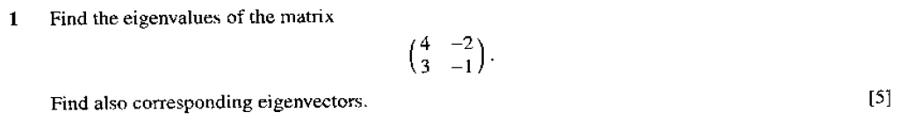
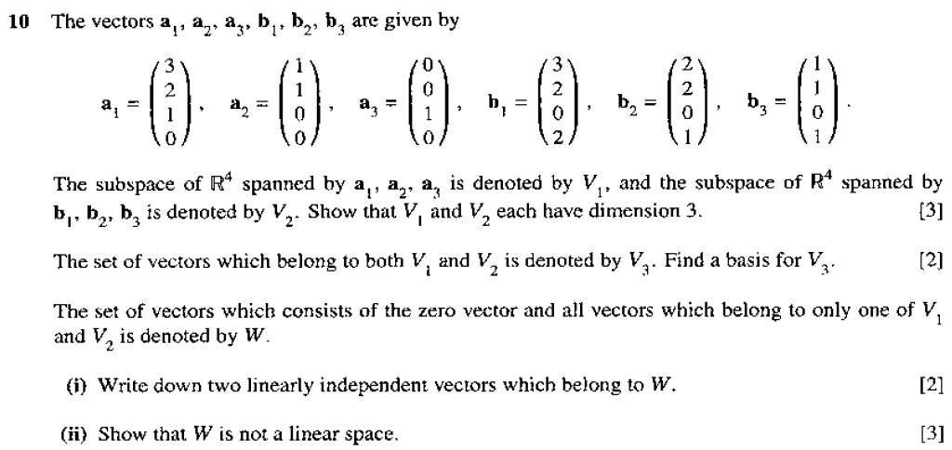
May/June 2002 (9231/01)

Slide 128
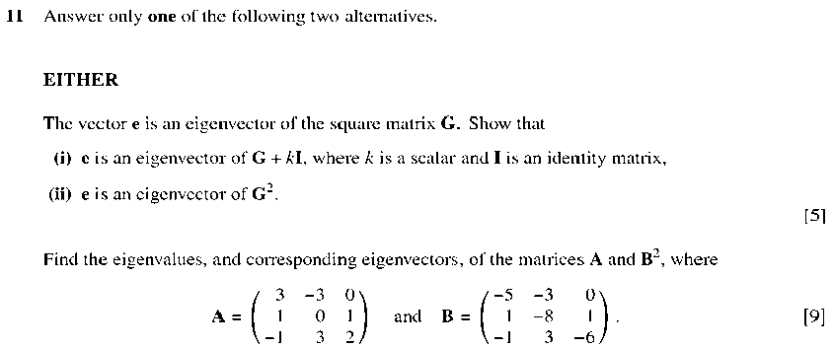
Oct/Nov 2002

Slide 129
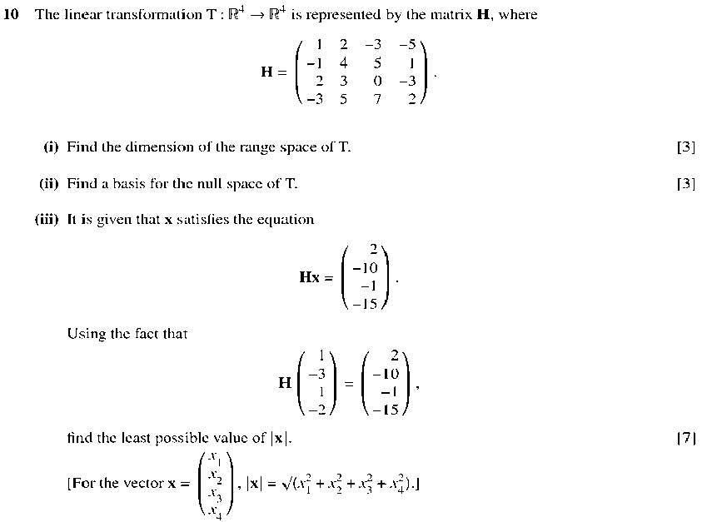

Slide 130
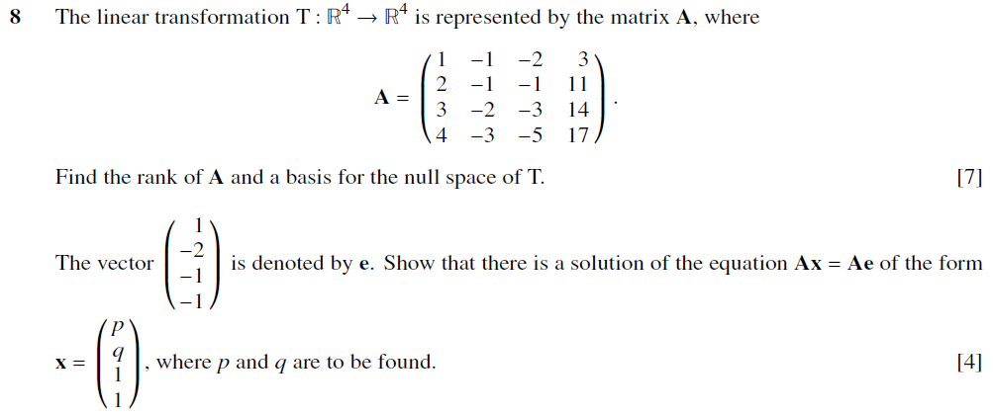
May/June 2003 (9231/01)

Slide 131
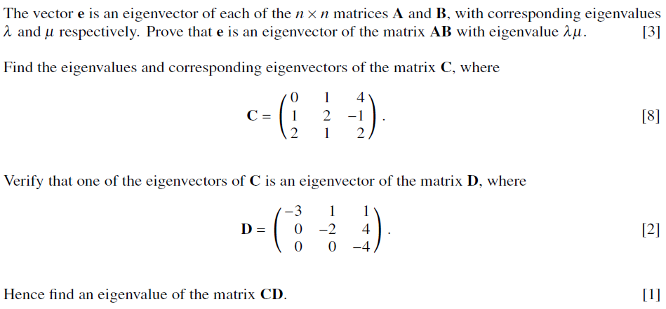

Slide 132
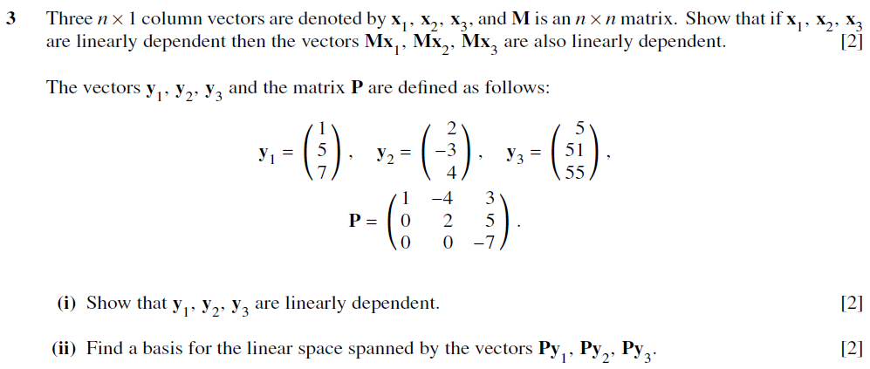
Oct/Nov 2003 (9231/01)

Slide 133
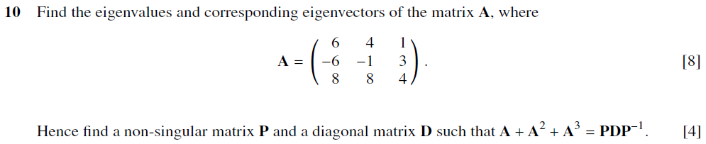

Slide 134
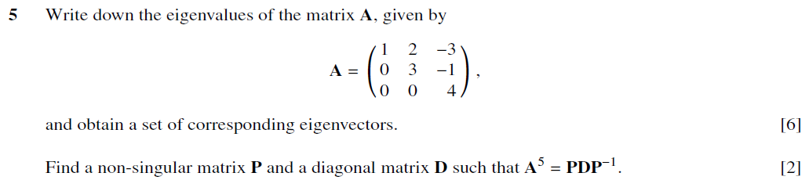
May/June 2004 (9231/01)

Slide 135
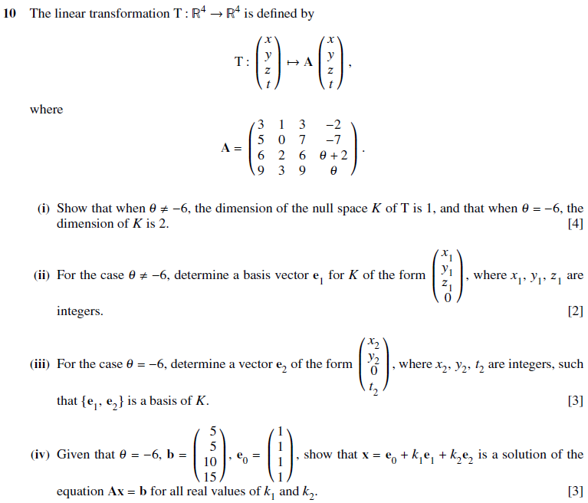

Slide 136
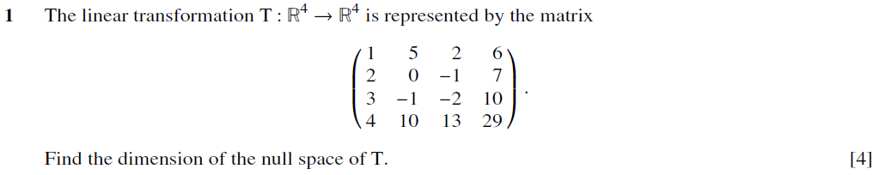
Oct/Nov 2004 (9231/01)

Slide 137
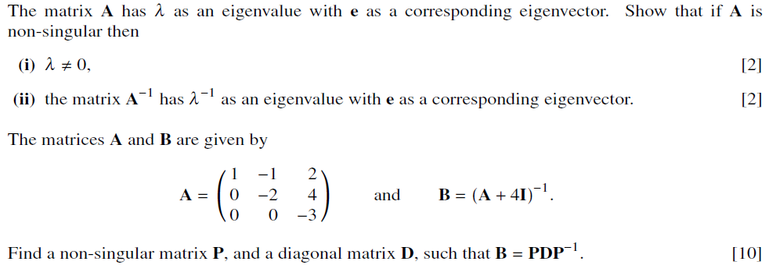

Slide 138
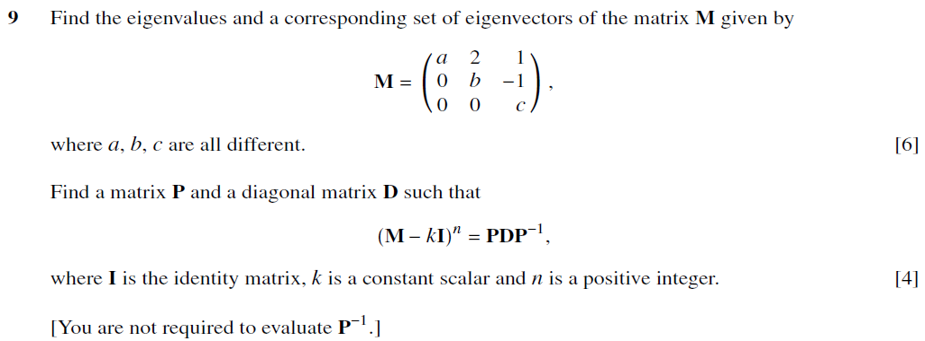
May/June 2005

Slide 139
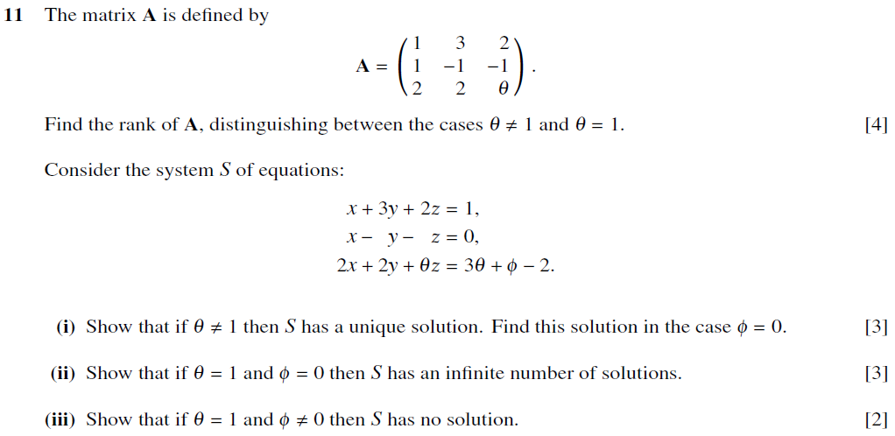

Slide 140
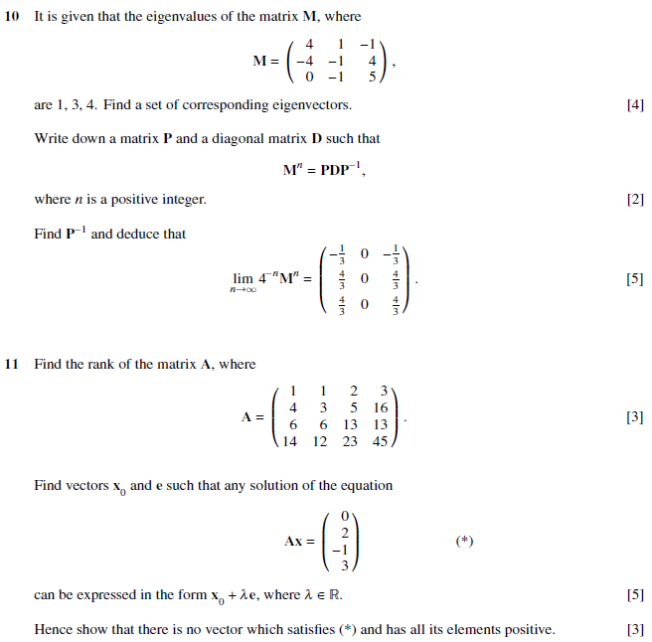
Oct/Nov 2005 (9231/01)

Slide 141
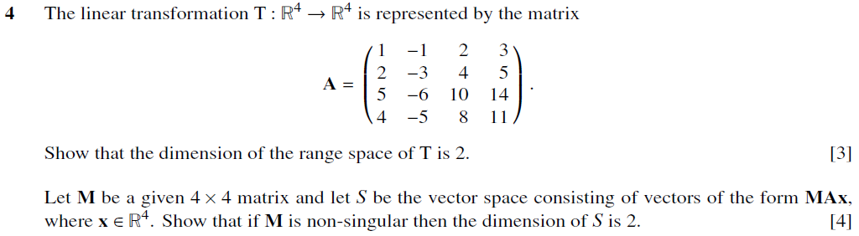
May/June 2006 (9231/01)

Slide 142
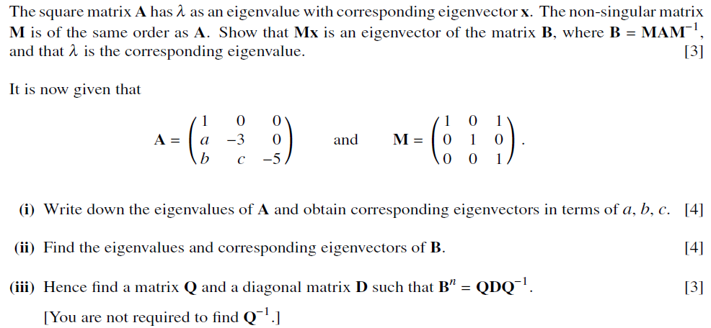

Slide 143
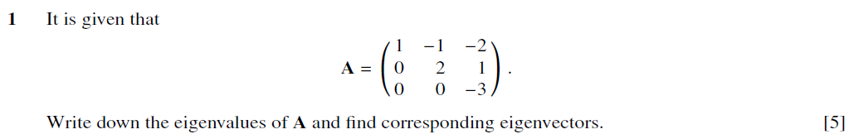
Oct/Nov 2006 (9231/01)

Slide 144
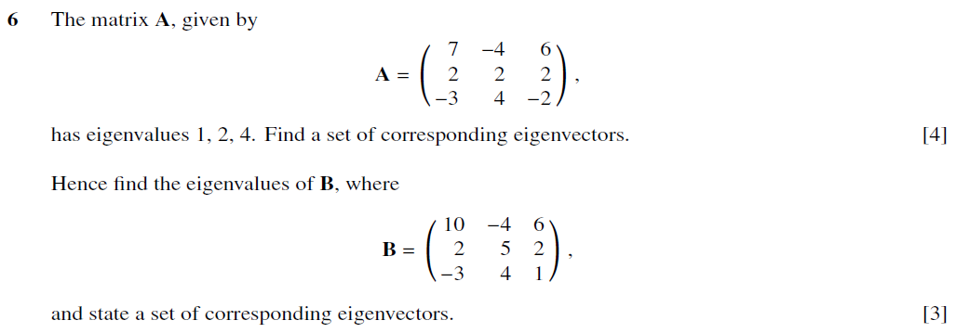
May/June 2007 (9231/01)

Slide 145
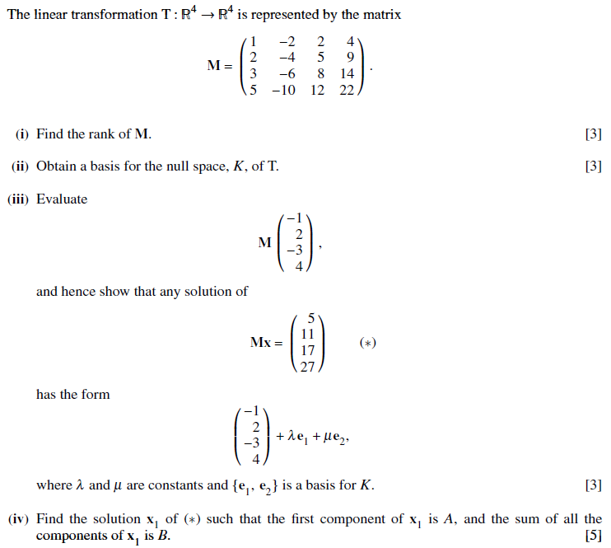

Slide 146
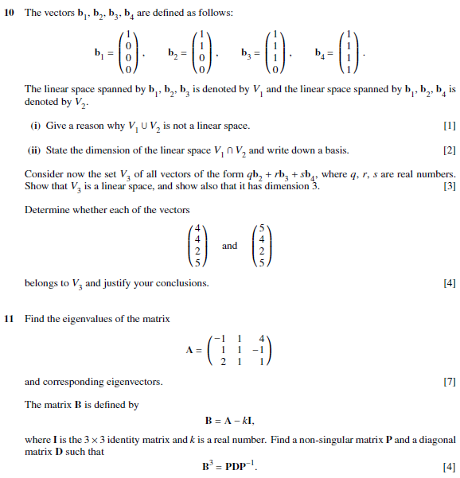
Oct/Nov 2007 (9231/01)

Slide 147
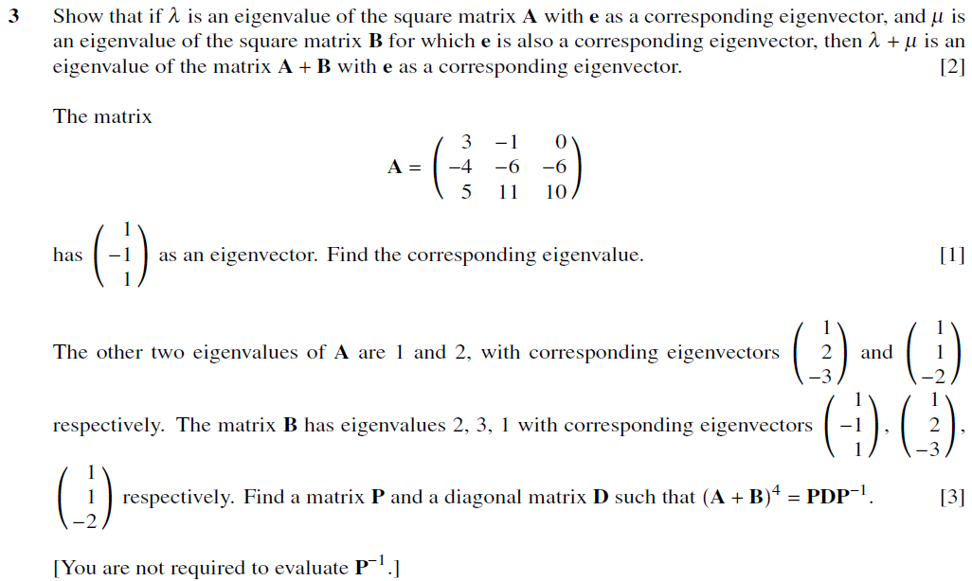
May/June 2008 (9231/01)

Slide 148
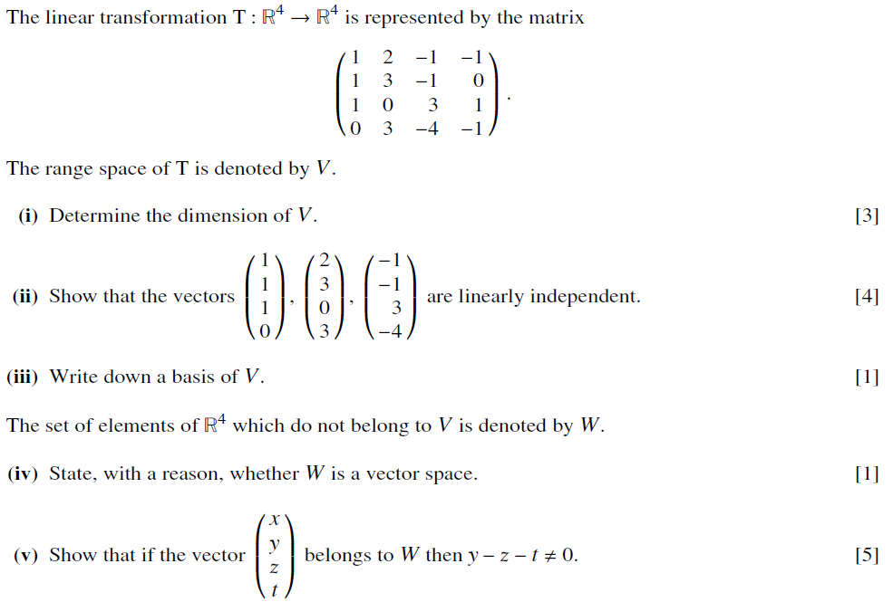

Slide 149
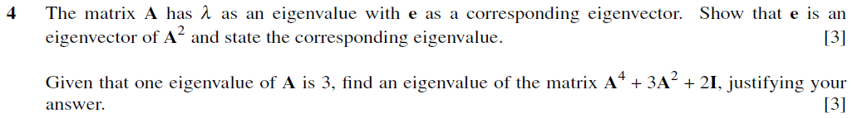
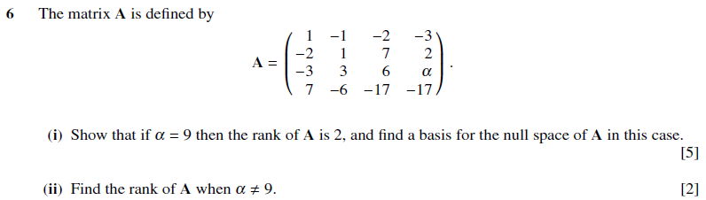
Oct/Nov 2008 (9231/01)

Slide 150
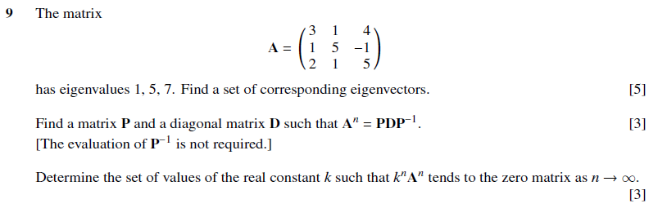
May/June 2009 (9231/01)

Slide 151
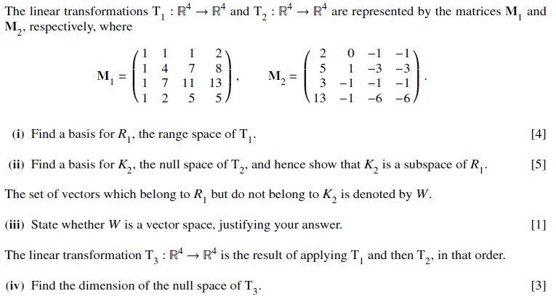

Slide 152

Oct/Nov 2009 (9231/01)

Slide 153

May/June 2010 (9231/11)

Slide 154

May/June 2010 (9231/13)

Slide 155


Slide 156

Oct/Nov 2010 (9231/01)

Slide 157


Slide 158
References:
1. Elementary Linear Algebra, 7th Edition
Howard Anton
John Wiley & Sons, Inc.
2. Schaum’s Outline of Linear Algebra, 4th Edition
Seymour Lipschutz, Marc Lipson
McGraw Hill

